Slide 1
3. Quantum Algorithms: Phase estimation
IBM Quantum Learning
1
© 2024 International Business Machines Corporation

Slide 2
Overview
Phase estimation problem
Warm-up: using the phase kickback
Iterating the unitary operation
Two control qubits
Two-qubit phase estimation
Quantum Fourier transform
Phase estimation procedure

Slide 3

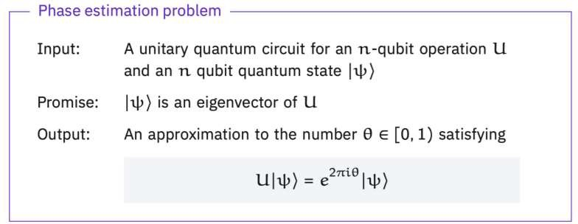

Slide 4
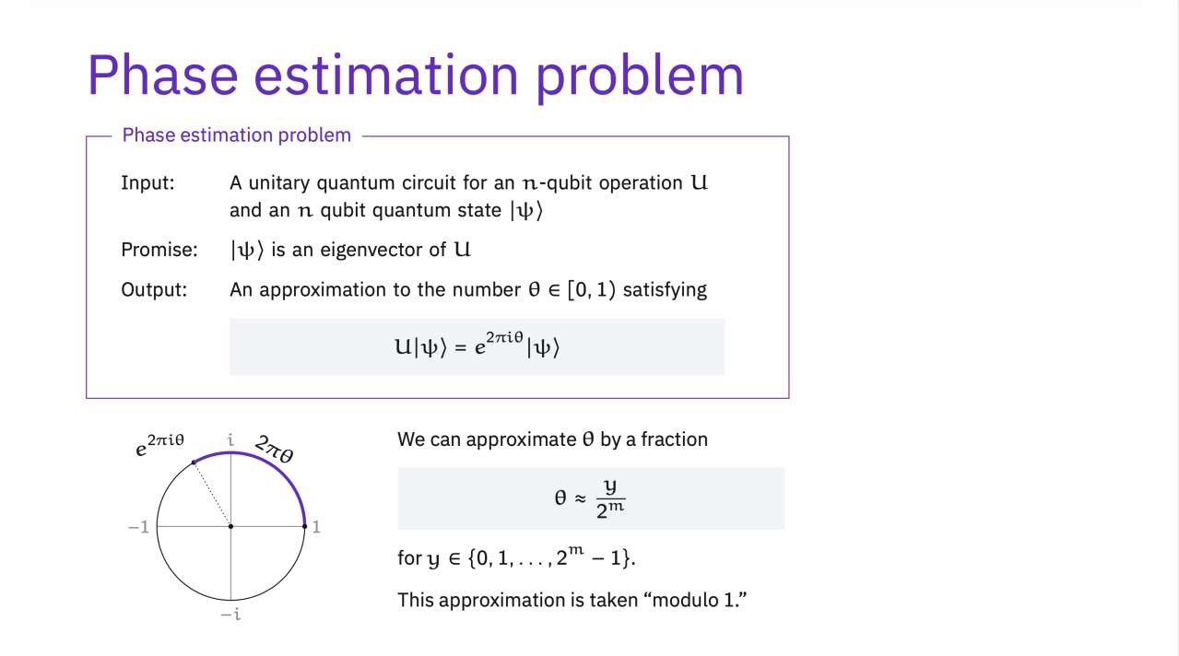

Slide 5
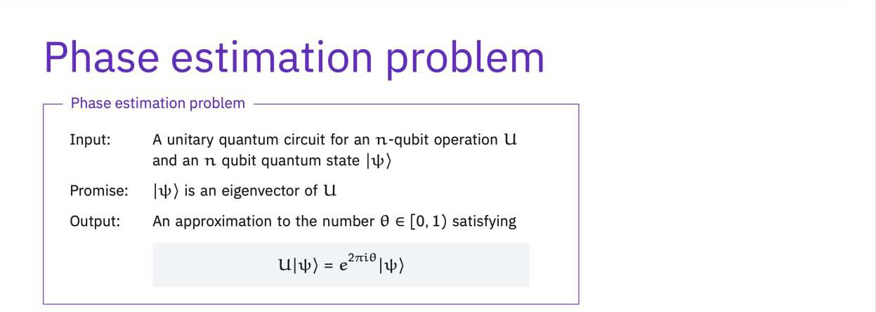
The Phase estimation problem is applied to the energy calculations for
quantum many-body systems and Shor's algorithm.
e.g. Shor’s algorithm : Acceleration from quasi-exponential to polynomial time.

Slide 6
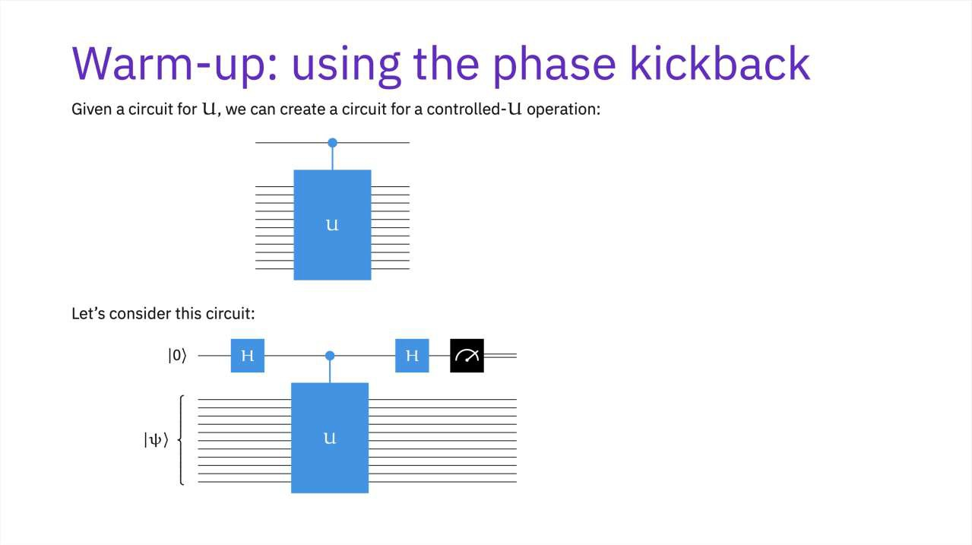

Slide 7
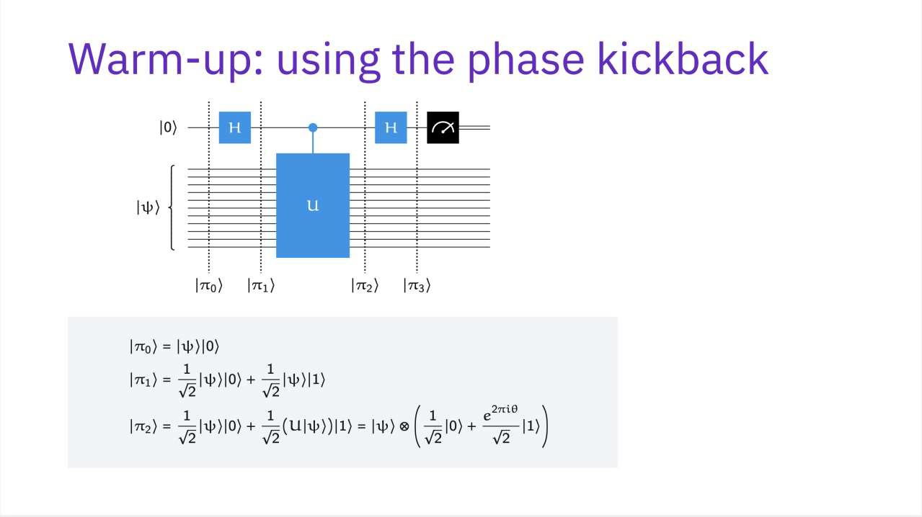

Slide 8
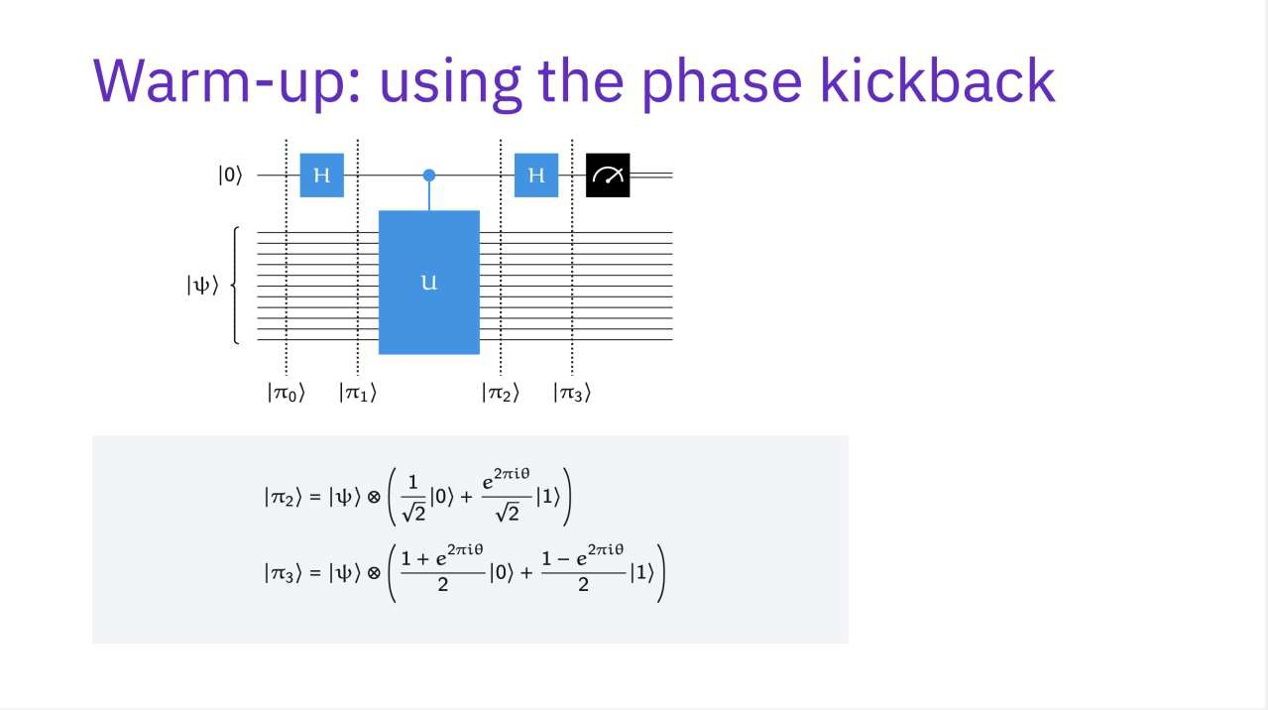

Slide 9
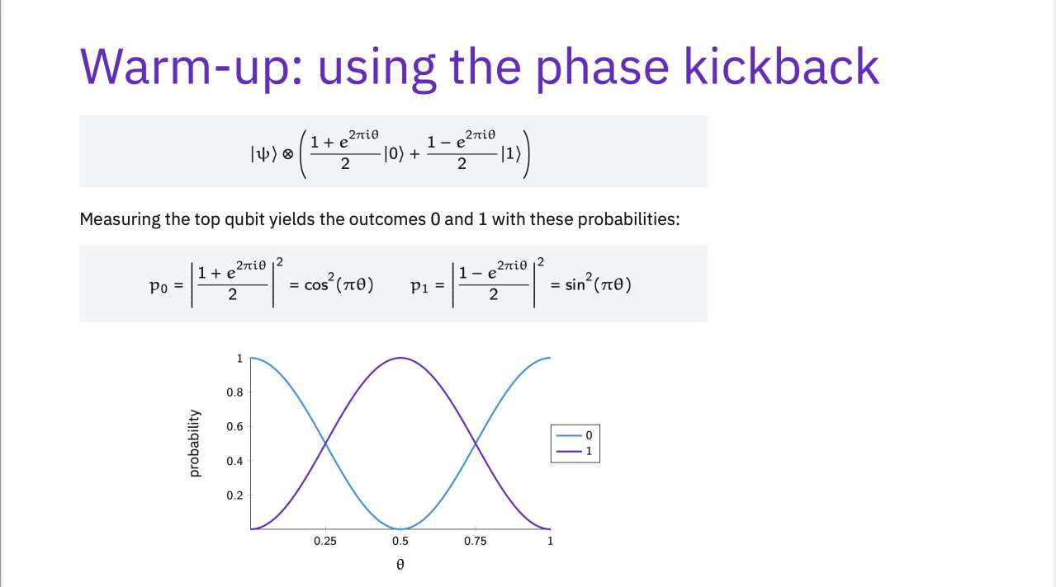

Slide 10
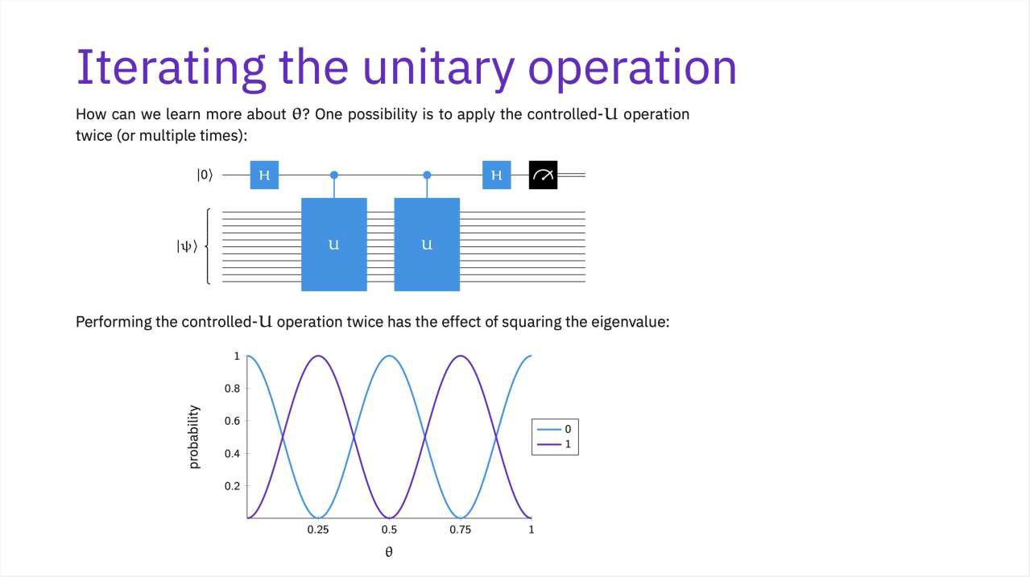

Slide 11
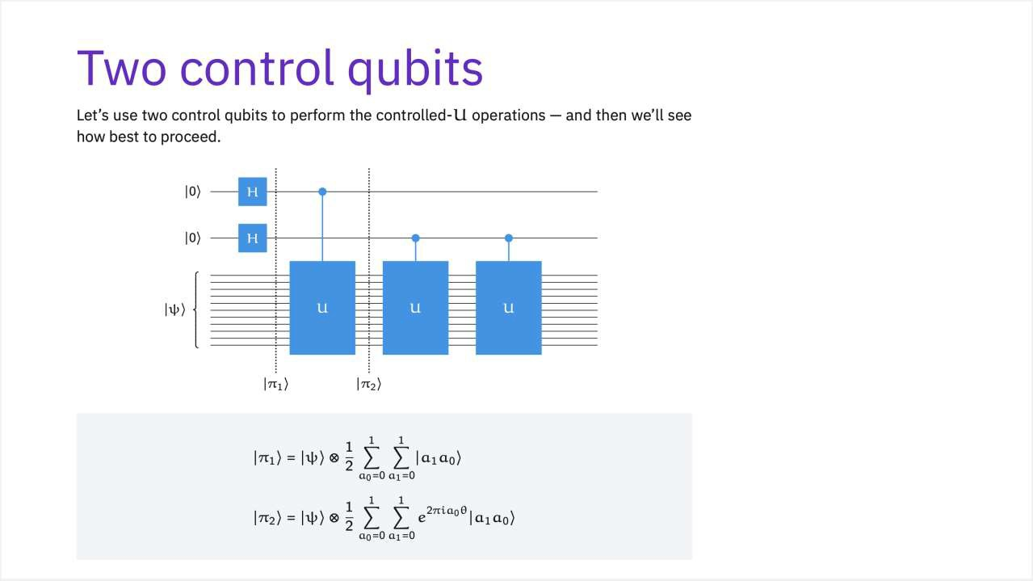

Slide 12
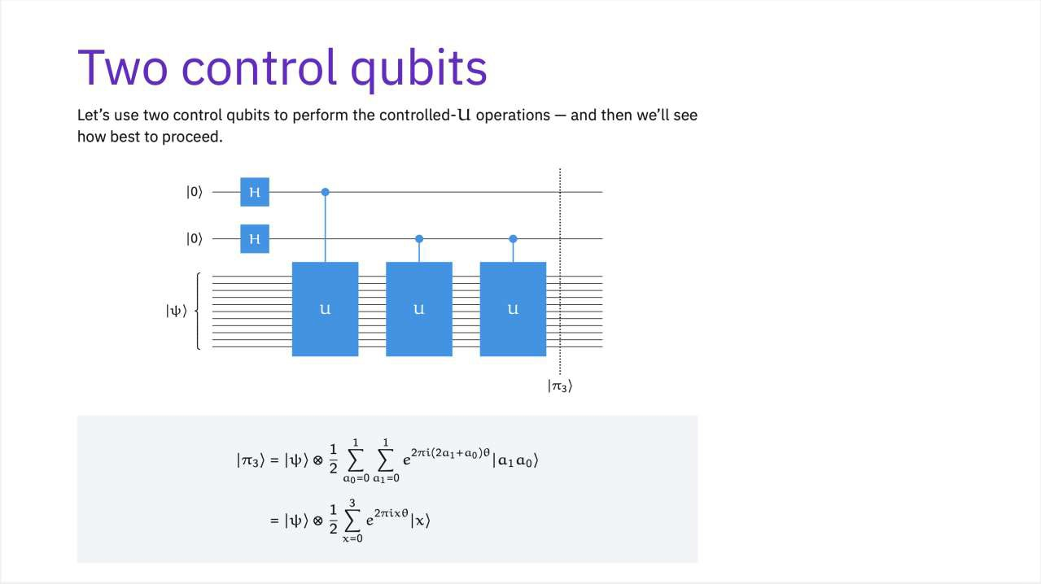
1 1
෍
_{෍ 𝑒}2𝜋𝑖 2𝑎₁+𝑎₀ 𝜃 _{|𝑎1𝑎0ۧ.}
𝑎₀=0 𝑎₁=0
_{= |0ۧ + 𝑒}2𝜋𝑖∗1𝜃_{|1ۧ + 𝑒}2𝜋𝑖∗2𝜃 _{2ۧ + 𝑒}2𝜋𝑖∗3𝜃 _{3ۧ}
13

Slide 13
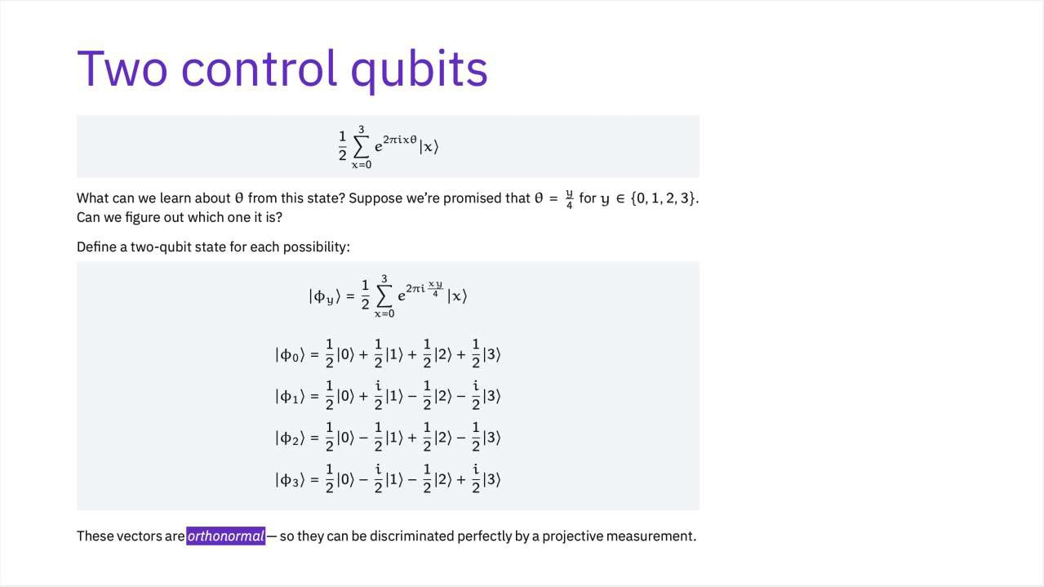

Slide 14
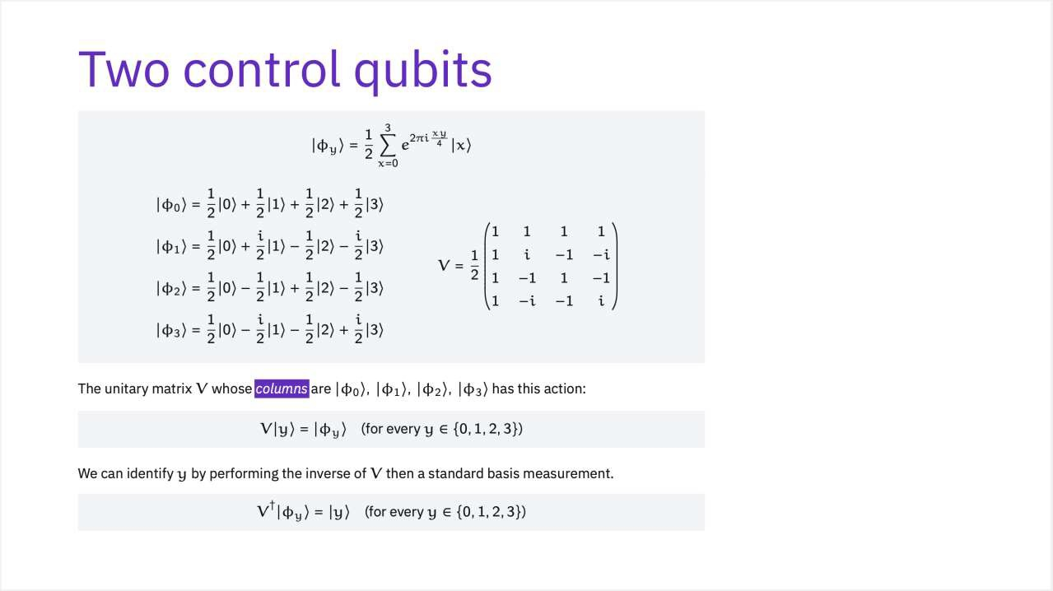

Slide 15
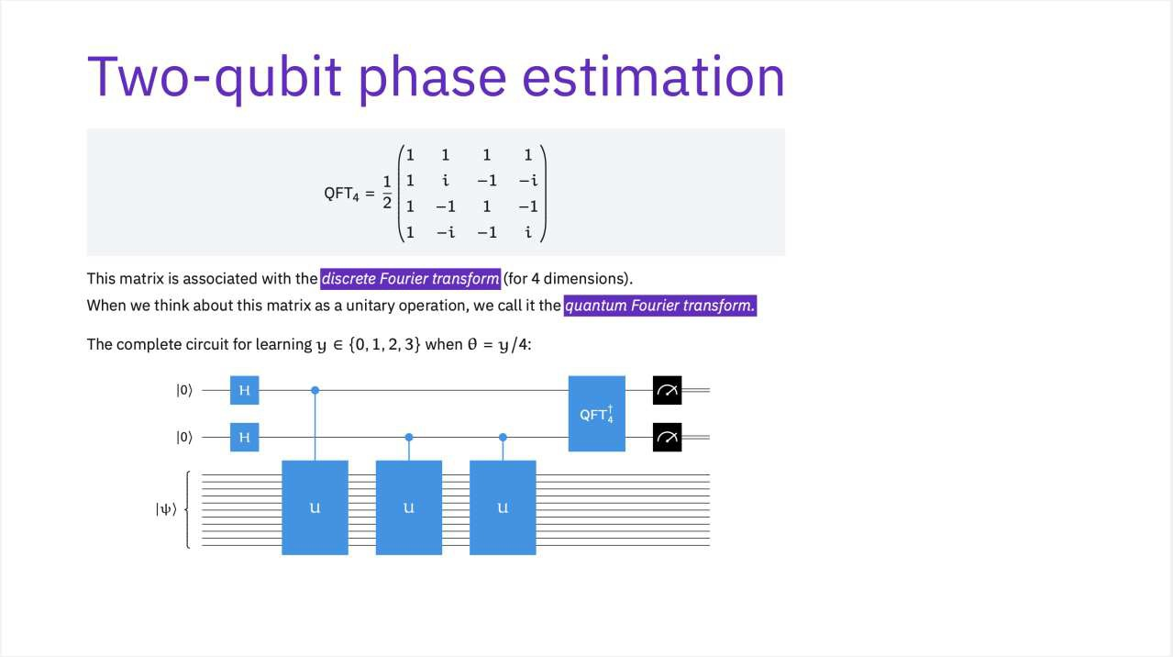

Slide 16
Overview
Phase estimation problem
Warm-up: using the phase kickback
Iterating the unitary operation
Two control qubits
Two-qubit phase estimation
Quantum Fourier transform
Phase estimation procedure

Slide 17

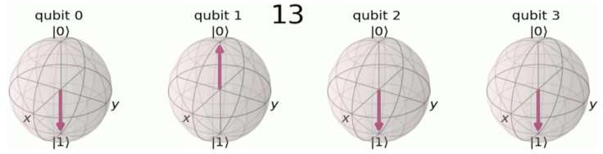
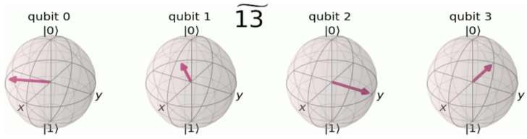
The quantum Fourier transform transform between the computational basis and the Fourier basis.

Slide 18

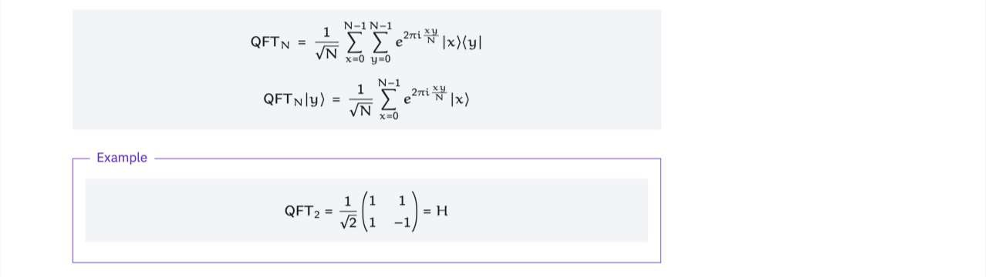

Slide 19
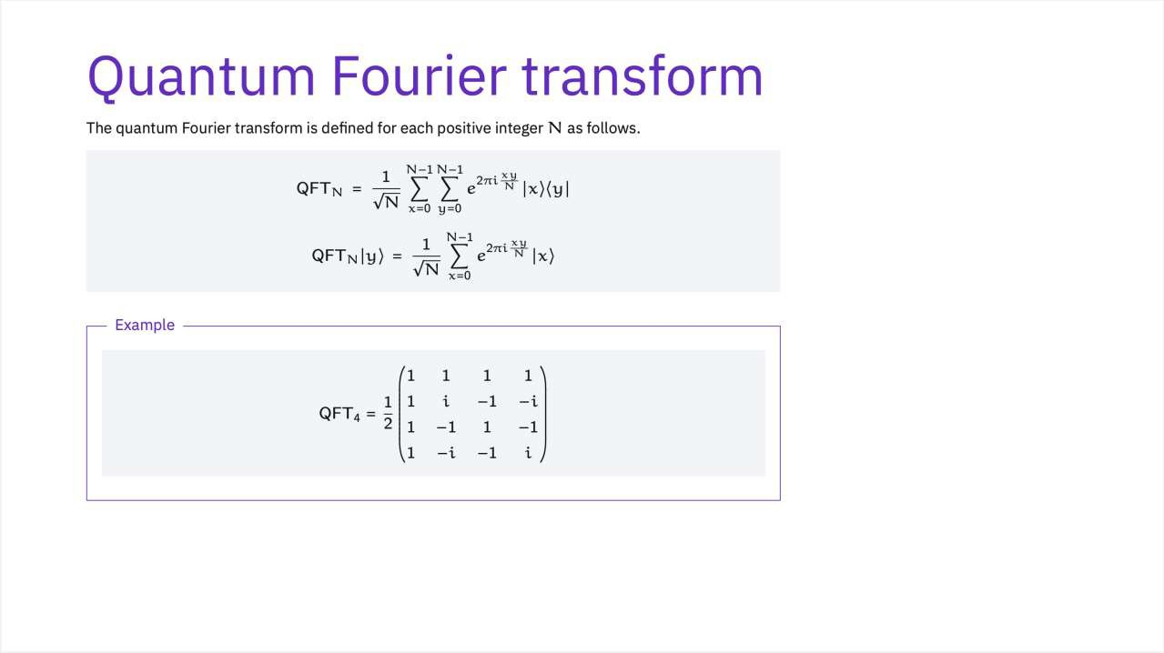

Slide 20
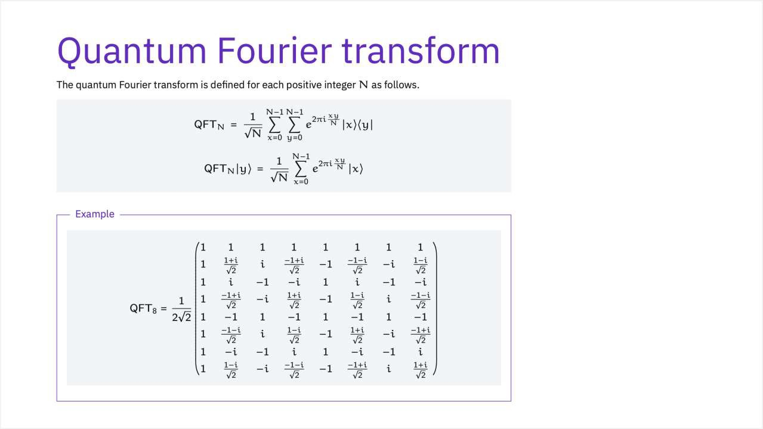

Slide 21
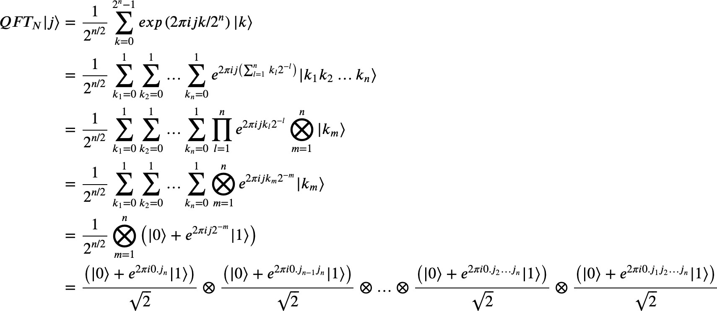
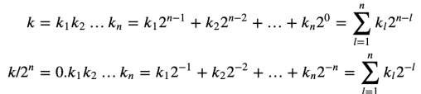
Quantum Fourier transform
QFT_{N}

Slide 22

Quantum Fourier transform
QFT_{N}

Slide 23
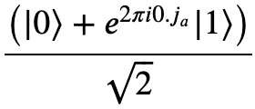



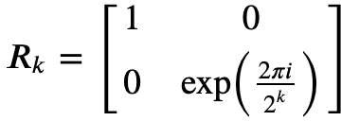



Quantum Fourier transform
H
𝑅_{𝑘}
k digits in fraction part

Slide 24
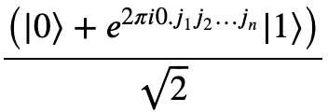



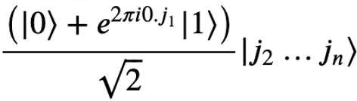
Quantum Fourier transform
|𝑗₁ۧ
H
𝑅₂
…
^{𝑅}𝑛−1
𝑅_{𝑛}
|𝑗₂ۧ
|𝑗₂ۧ
^{|𝑗}𝑛−1ۧ
|𝑗_{𝑛}ۧ
…
…
^{|𝑗}𝑛−1ۧ
|𝑗_{𝑛}ۧ

Slide 25
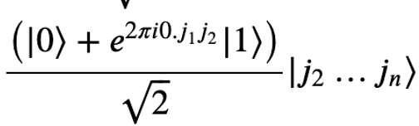
Quantum Fourier transform
|𝑗₁ۧ
H
𝑅₂
…
^{𝑅}𝑛−1
𝑅_{𝑛}
|𝑗₂ۧ
|𝑗₂ۧ
^{|𝑗}𝑛−1ۧ
|𝑗_{𝑛}ۧ
…
…
^{|𝑗}𝑛−1ۧ
|𝑗_{𝑛}ۧ

Slide 26
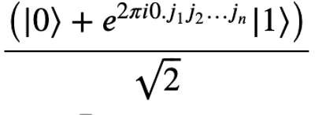
Quantum Fourier transform
|𝑗₁ۧ
H
𝑅₂
…
^{𝑅}𝑛−1
𝑅_{𝑛}
|𝑗₂ۧ
|𝑗₂ۧ
^{|𝑗}𝑛−1ۧ
|𝑗_{𝑛}ۧ
…
…
^{|𝑗}𝑛−1ۧ
|𝑗_{𝑛}ۧ
|𝑗₂, … 𝑗_{𝑛}ۧ

Slide 27






Quantum Fourier transform
The implementation is recursive in nature.
|𝑗₁ۧ
H
𝑅₂
…
^{𝑅}𝑛−1
𝑅
(|0ۧ + 𝑒^{2𝜋𝑖0.𝑗1𝑗2…𝑗𝑛} |1ۧ)
𝑛
2
|𝑗₂ۧ
H
𝑅₂
…
…
…
…
…
^{𝑅}𝑛−1
^{|𝑗}𝑛−1ۧ
|𝑗_{𝑛}ۧ
(|0ۧ + 𝑒^{2𝜋𝑖0.𝑗𝑛} |1ۧ)
2

Slide 28














Quantum Fourier transform
At last, Swap operations are executed.
(|0ۧ + 𝑒^{2𝜋𝑖0.𝑗1𝑗2…𝑗𝑛} |1ۧ)
(|0ۧ + 𝑒^{2𝜋𝑖0.𝑗𝑛} |1ۧ)
2
(|0ۧ + 𝑒^{2𝜋𝑖0.𝑗2…𝑗𝑛} |1ۧ)
 |  | …
2
(|0ۧ + 𝑒^{2𝜋𝑖0.𝑗𝑛−1𝑗𝑛} |1ۧ)
2
2
…
…
(|0ۧ + 𝑒^{2𝜋𝑖0.𝑗𝑛−1𝑗𝑛} |1ۧ)
(|0ۧ + 𝑒^{2𝜋𝑖0.𝑗2…𝑗𝑛} |1ۧ)
2
(|0ۧ + 𝑒^{2𝜋𝑖0.𝑗𝑛} |1ۧ)
2
(|0ۧ + 𝑒^{2𝜋𝑖0.𝑗1𝑗2…𝑗𝑛} |1ۧ)
2
2
↦
(|0ۧ + 𝑒^{2𝜋𝑖0.𝑗𝑛} |1ۧ)
⨂
(|0ۧ + 𝑒^{2𝜋𝑖0.𝑗𝑛−1𝑗𝑛} |1ۧ)
…
(|0ۧ + 𝑒^{2𝜋𝑖0.𝑗2…𝑗𝑛} |1ۧ)
(|0ۧ + 𝑒^{2𝜋𝑖0.𝑗1𝑗2…𝑗𝑛} |1ۧ)
⨂ ⨂
⨂
2
2
2
2

Slide 29
Overview
Phase estimation problem
Warm-up: using the phase kickback
Iterating the unitary operation
Two control qubits
Two-qubit phase estimation
Quantum Fourier transform
Phase estimation procedure

Slide 30
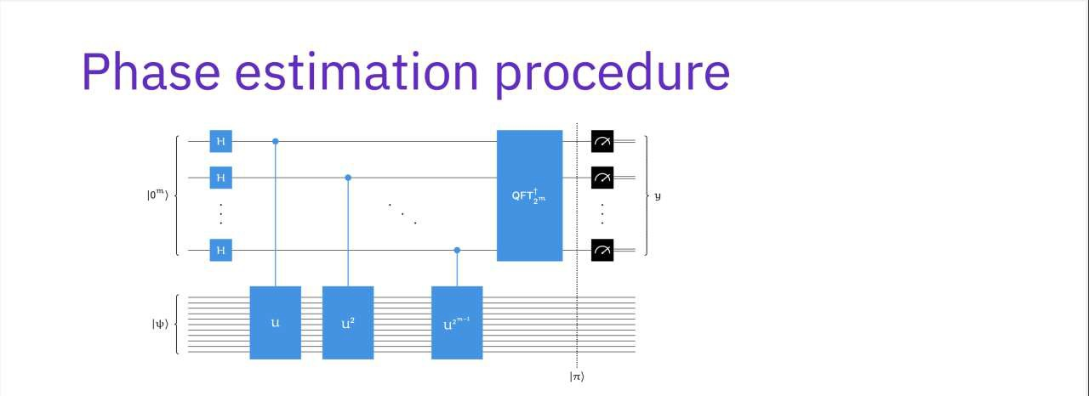
2^{m}−1
෍
x=0
1
_{e}2πixθ_{|xۧ}
|ψۧ ໆ
₂m/2

Slide 31
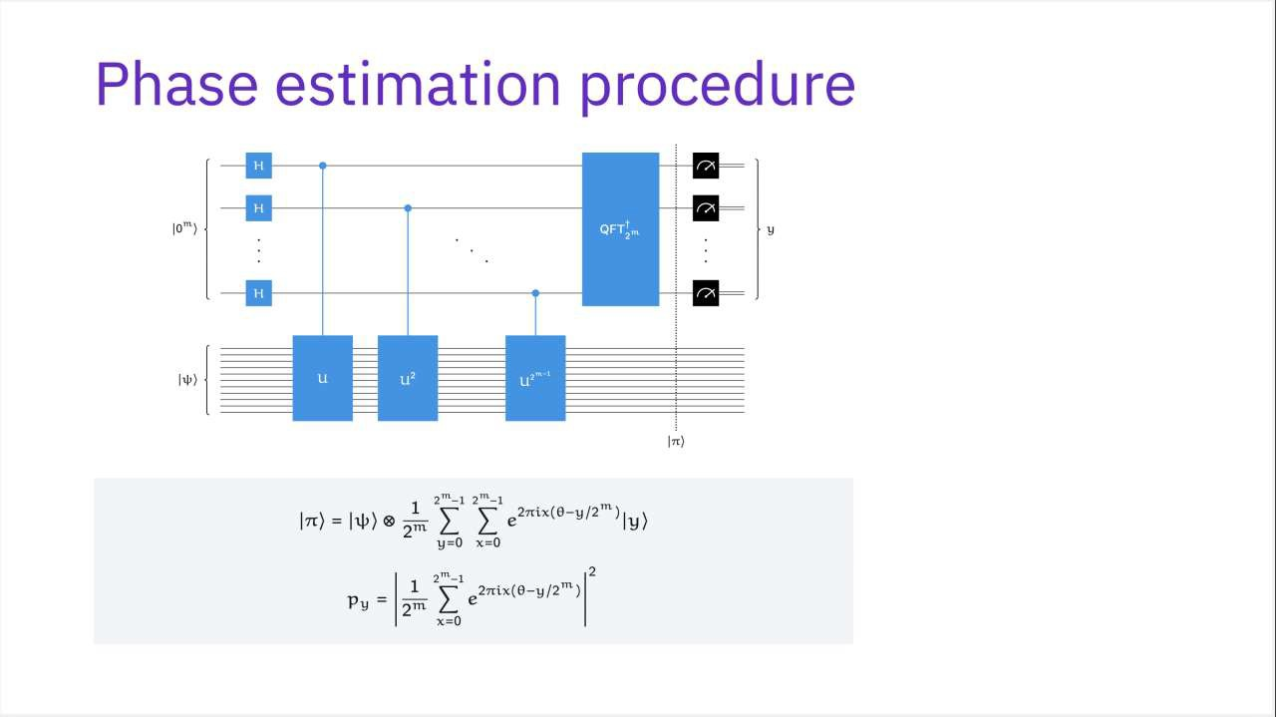

Slide 32
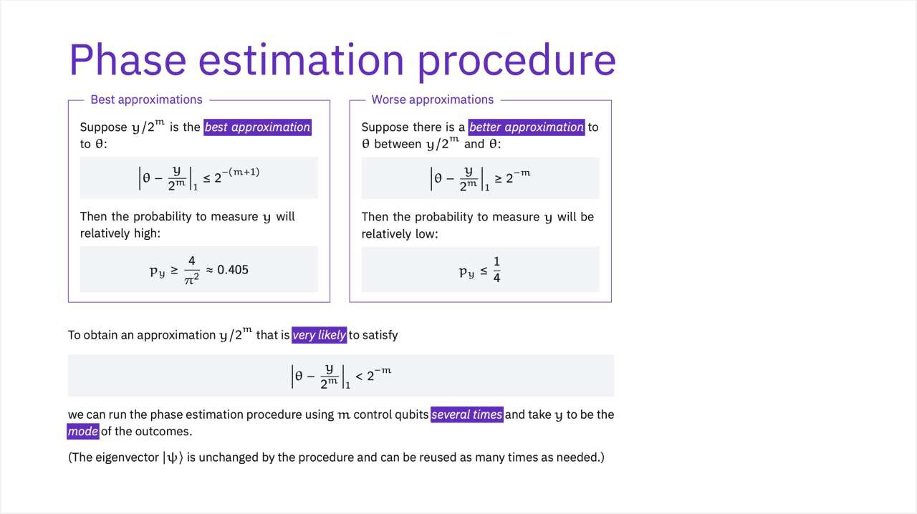

Slide 33

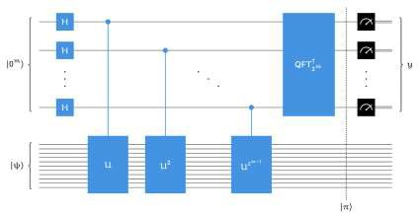
Summary
The Phase estimation problem can find the approximation to the number 𝜃 ∈ 0,1 satisfying
QFT transform between the computational basis and the Fourier basis.
QFT can be implemented in the quantum circuit.
The Phase estimation problem is solved using the QFT.

Slide 34
Reference
John Watrous, https://learning.quantum.ibm.com/course/fundamentals-of- quantum-algorithms/phase-estimation-and-factoring .

